Slide 1
NCI update – analyzing CyTOF data
12-6-2024
Ty Bottorff – Bioinformatics postdoc
Linsley lab

Slide 2
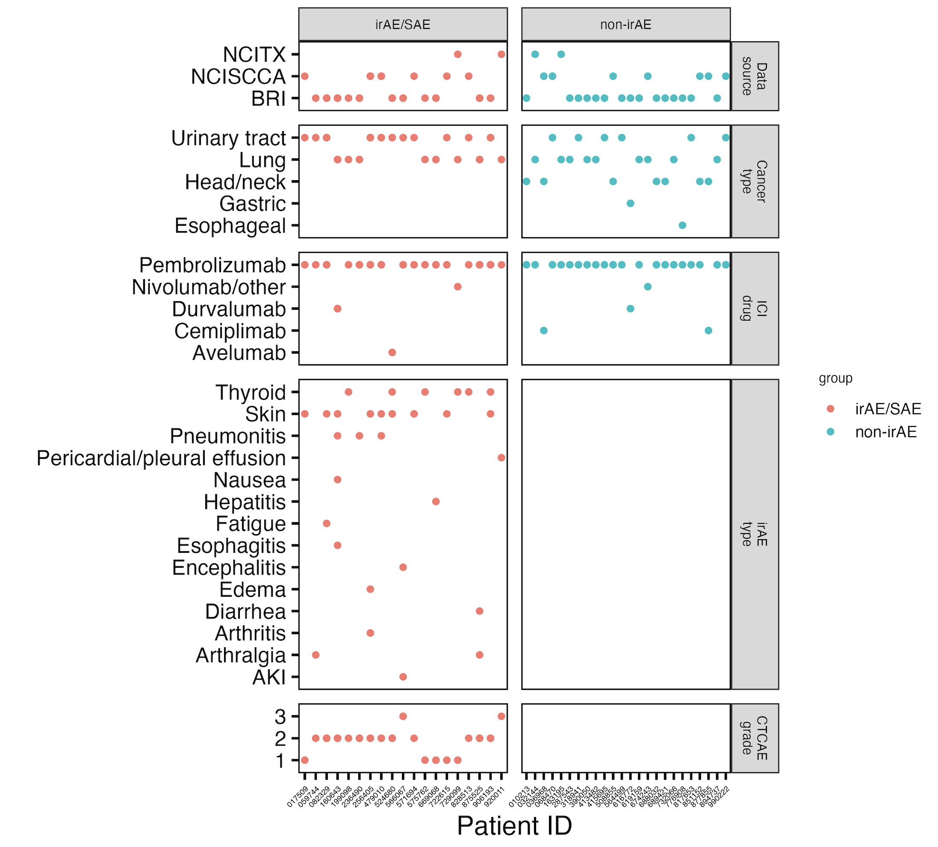
Cancer cohort metadata
Notes:
Ask Jane if grouping arthralgia and arthritis ok here for rheumatoid group (n = 3)

Slide 3
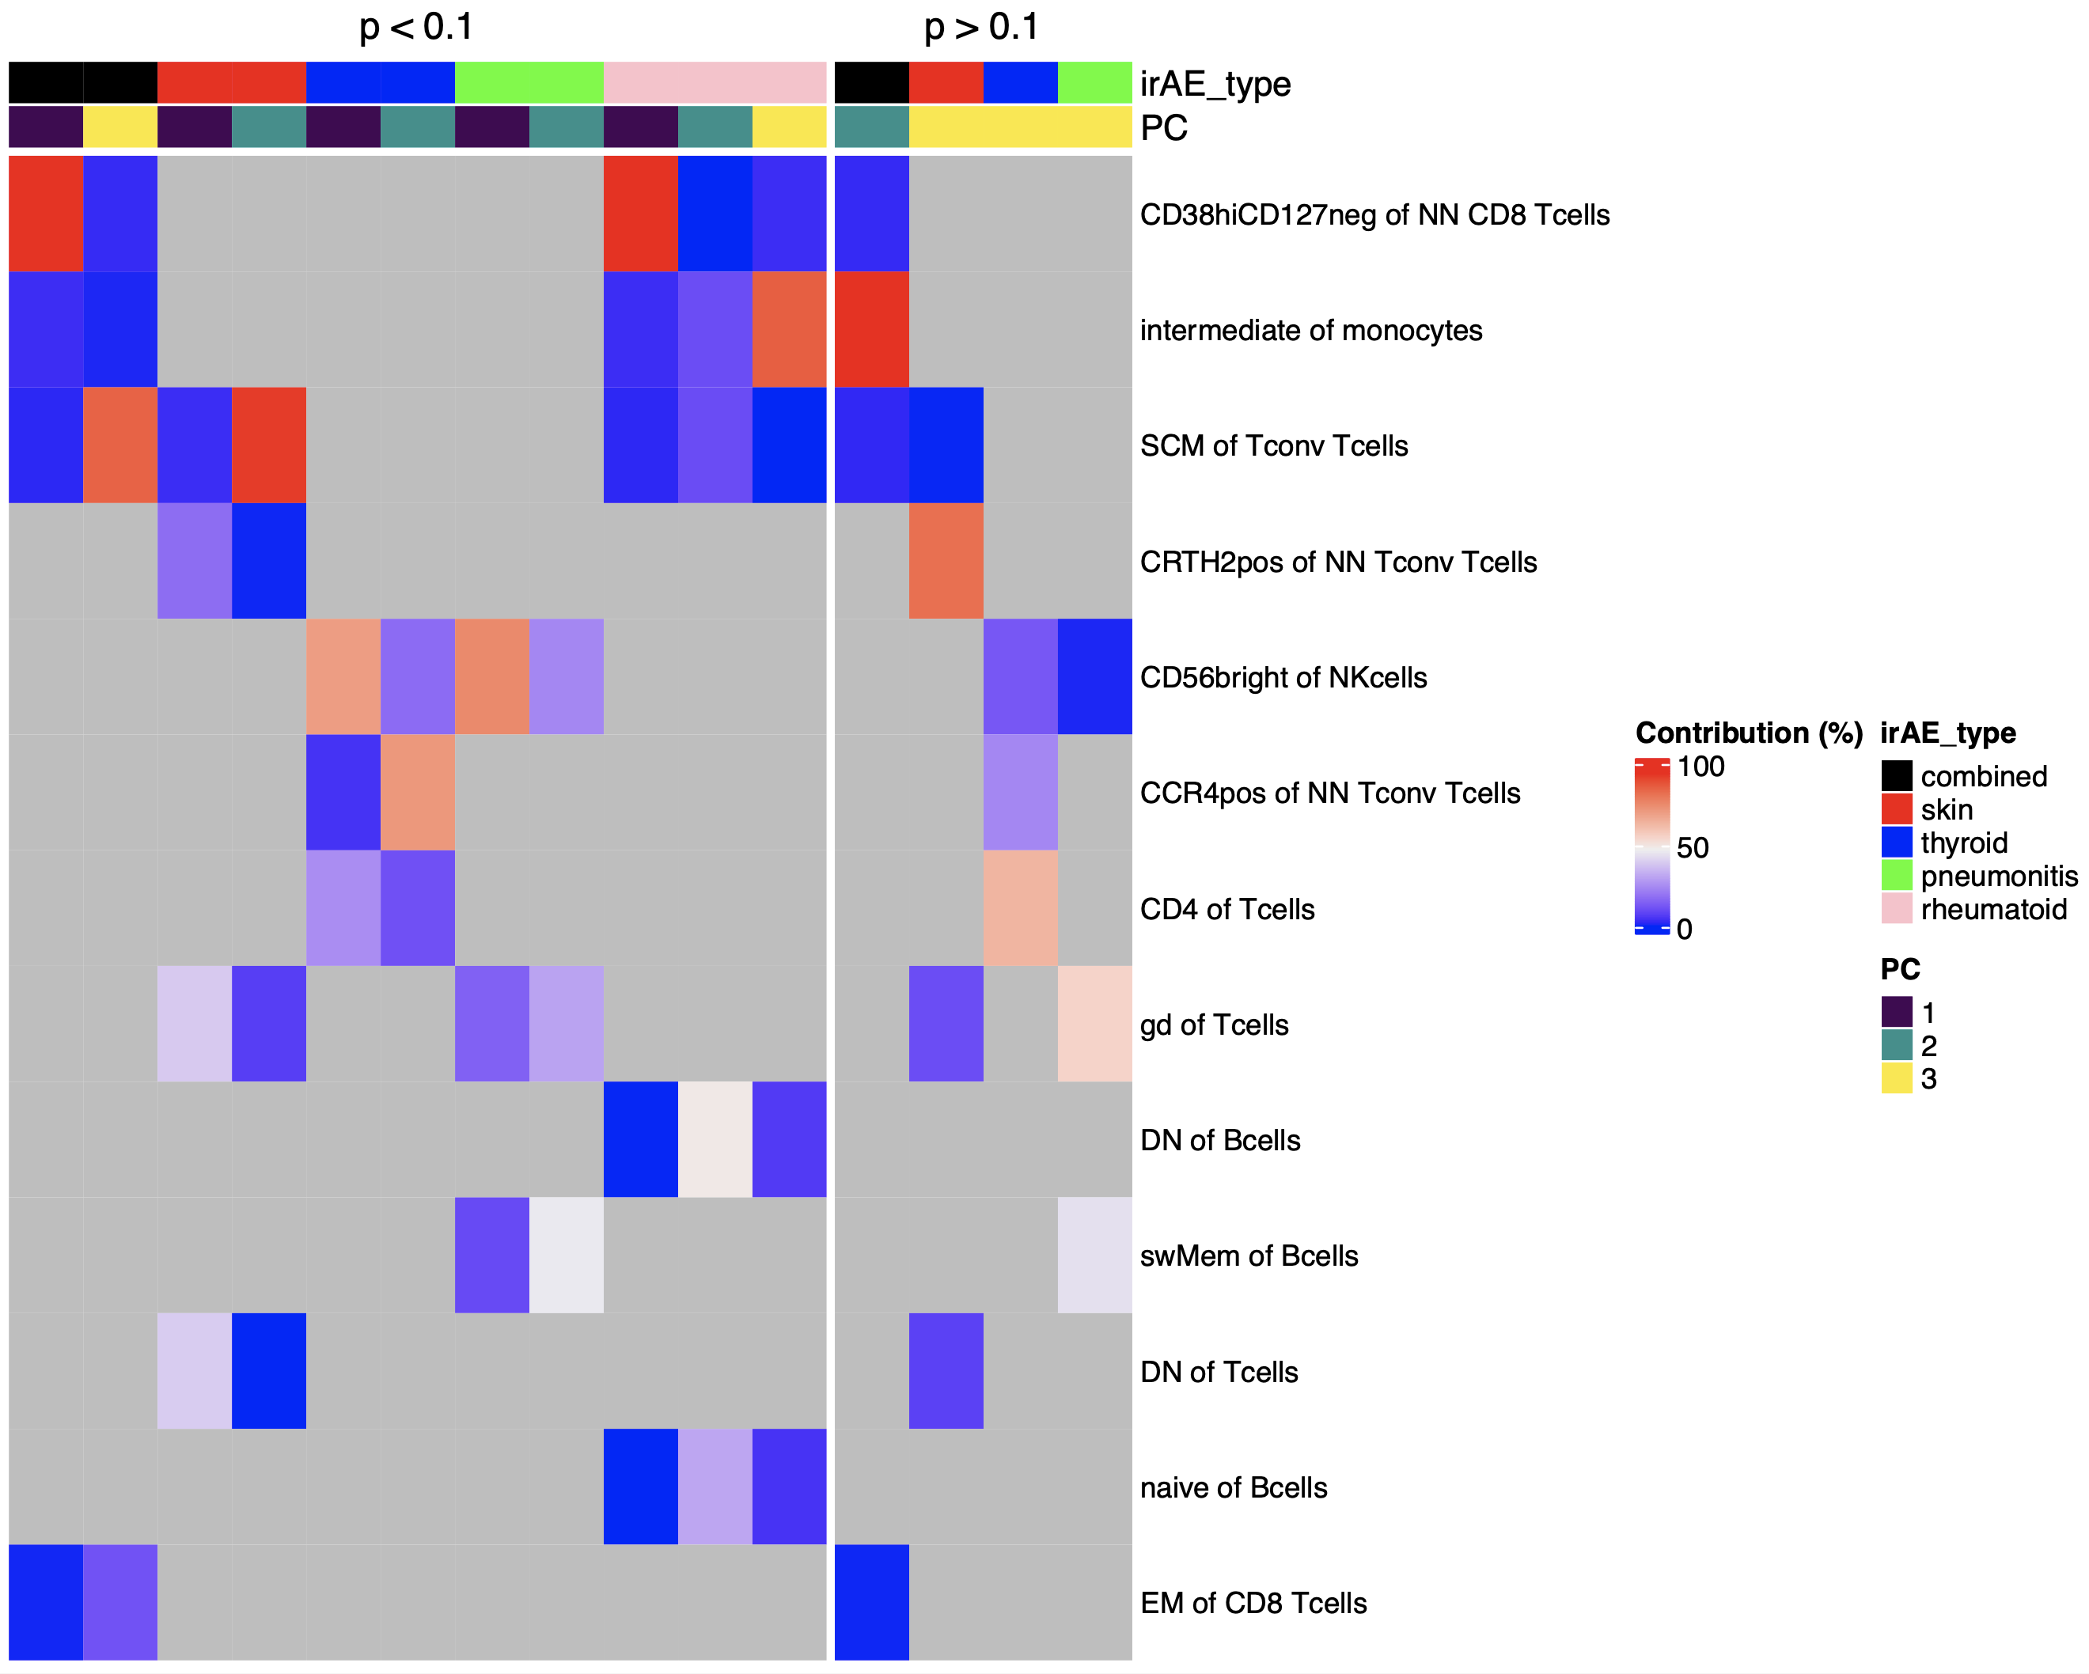
Some features are more irAE type-specific (baseline)
: reported to have higher freqs in irAE group at baseline (not seen here)
: reported to have higher freqs in irAE group at baseline (not seen here)
Notes:
Whittled down feature lists for each irAE type comparison to still get some PC comparison pval < 0.05 while not whittling down TOO far, these are the same cutoffs/feature lists for next few slides (except for pneumonitis, just took top 3 to be able to make PCs 1-3)
Other baseline literature results:
CD8s expected higher in irAE (not seen here)

Slide 4
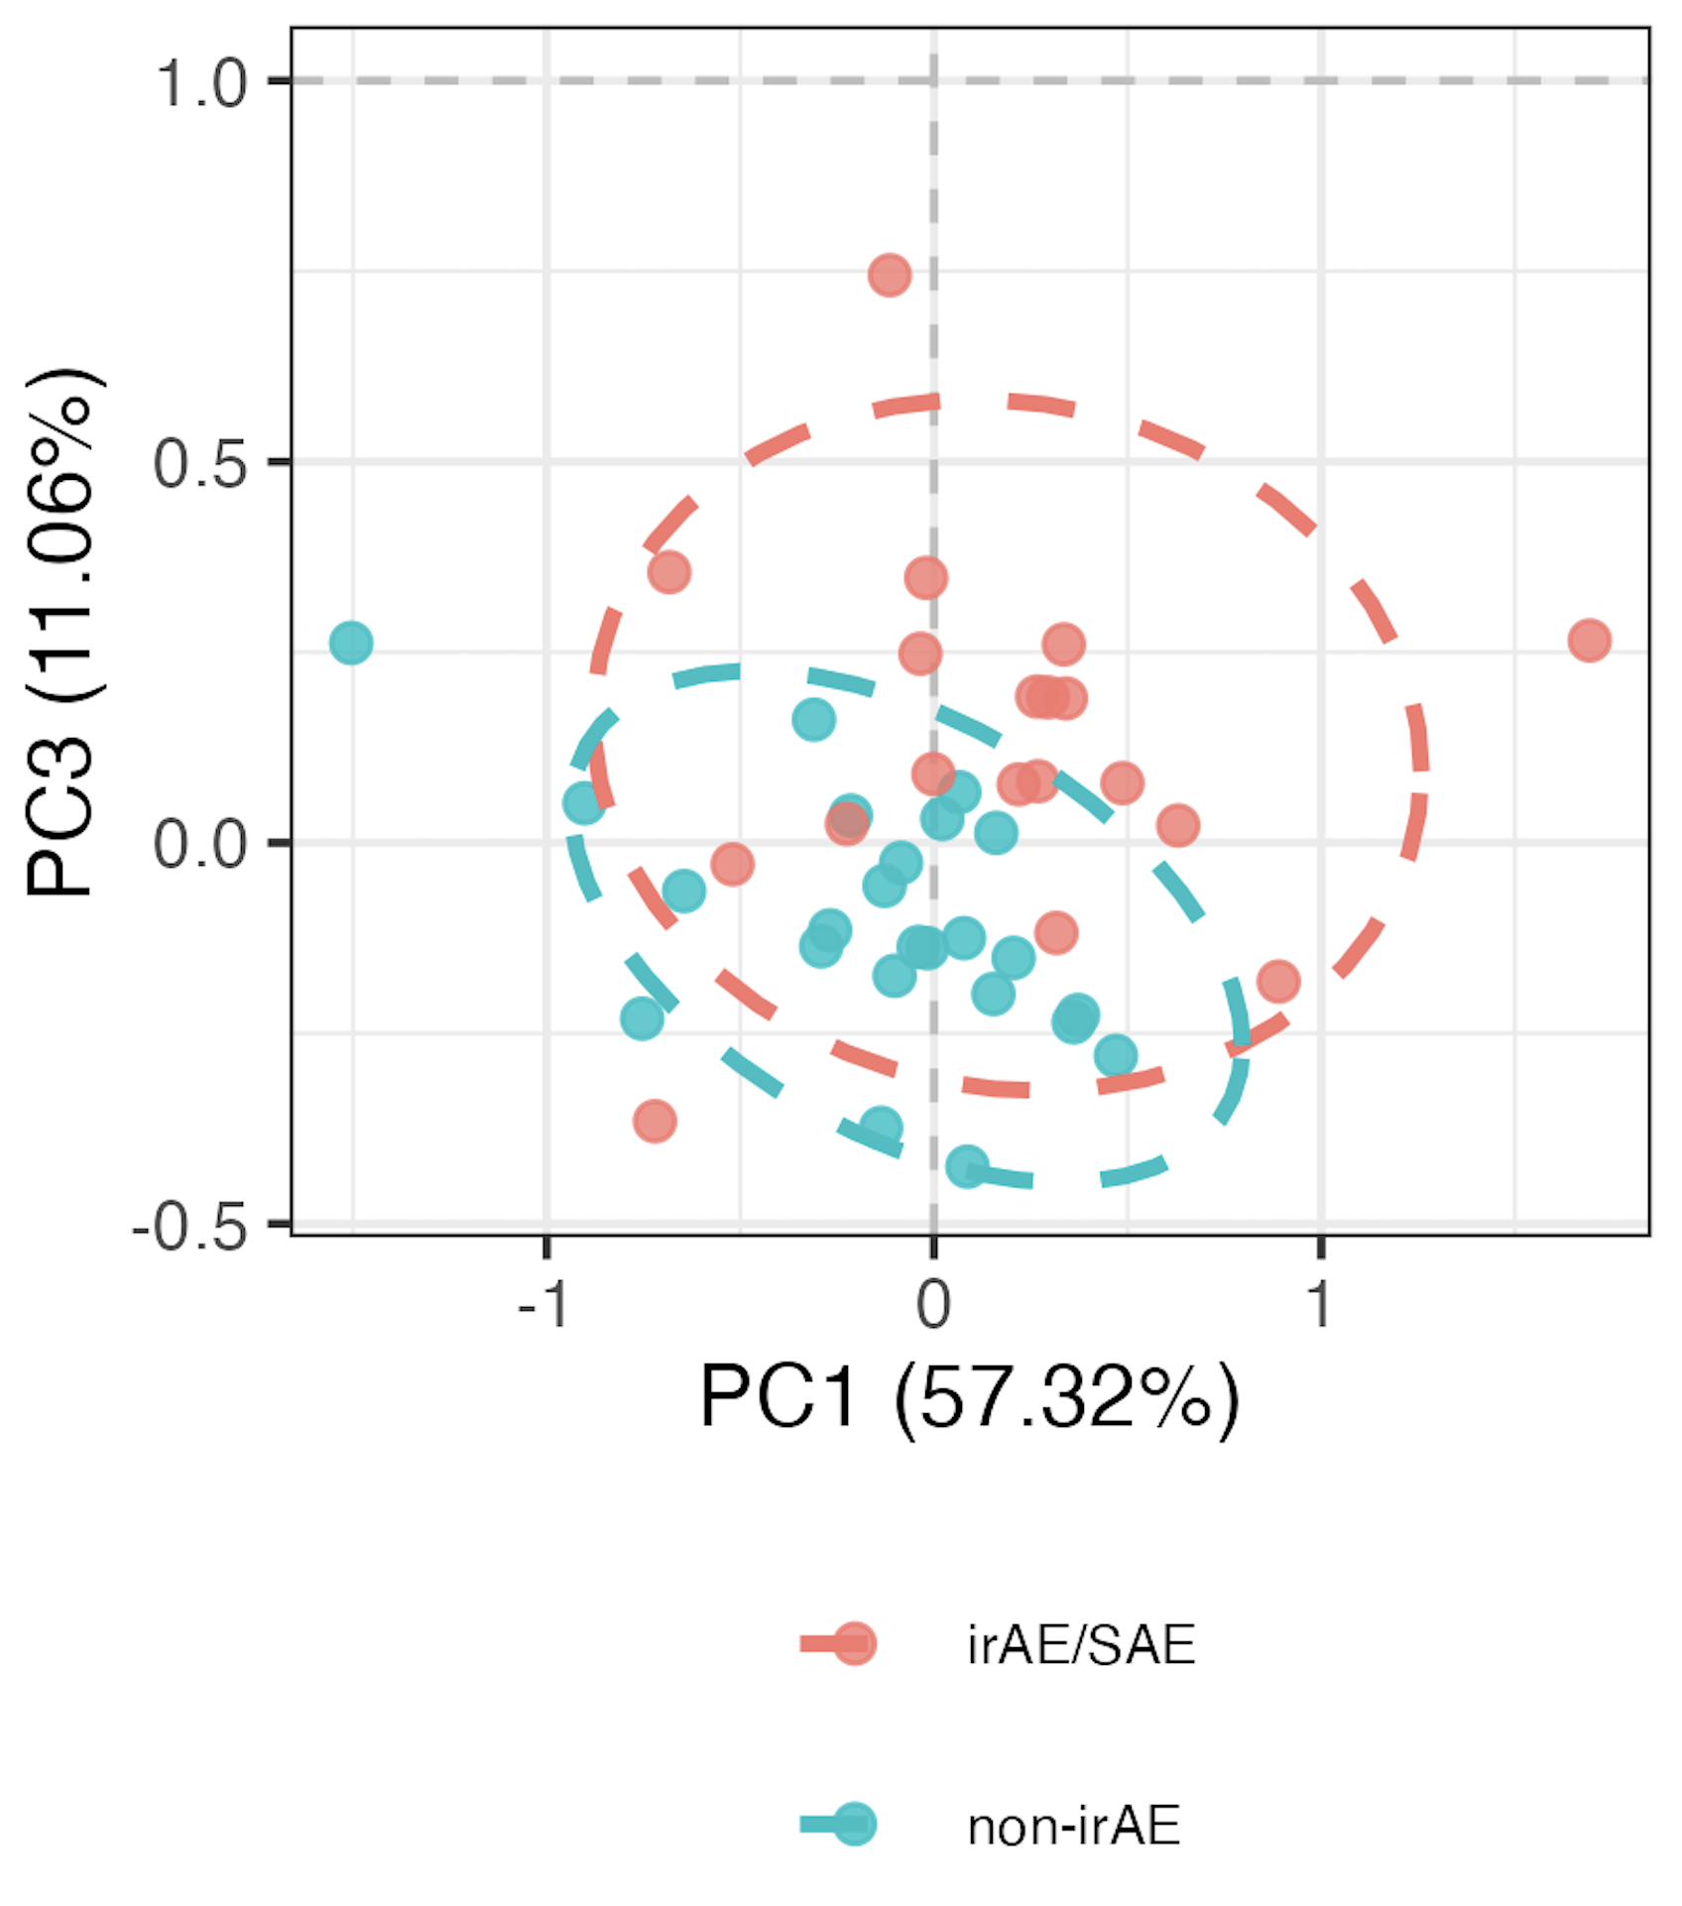
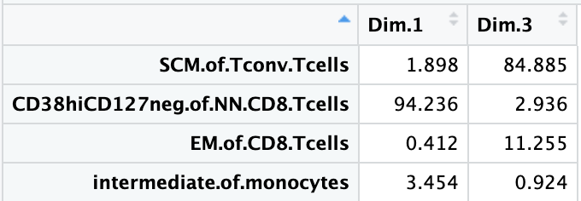
Using module of 4 baseline feature frequencies, can differentiate between those who develop irAEs
PC contributions
PC1 pval: 0.047
PC3 pval: 0.001
Notes:
Top feature module approach necessary to see pval < 0.05 in PCs 1-2
Module approach: whittle down # of features (arranging by pval from group comparison) while still retaining > 1 PC with pval < 0.05, ordering kind of arbitrary as padj have ties, so tried not to whittle down TOO much
Should also emphasize that modules are somewhat arbitrary in sense that multiple different configurations of mostly same features would likely work for each module approach taken here

Slide 5
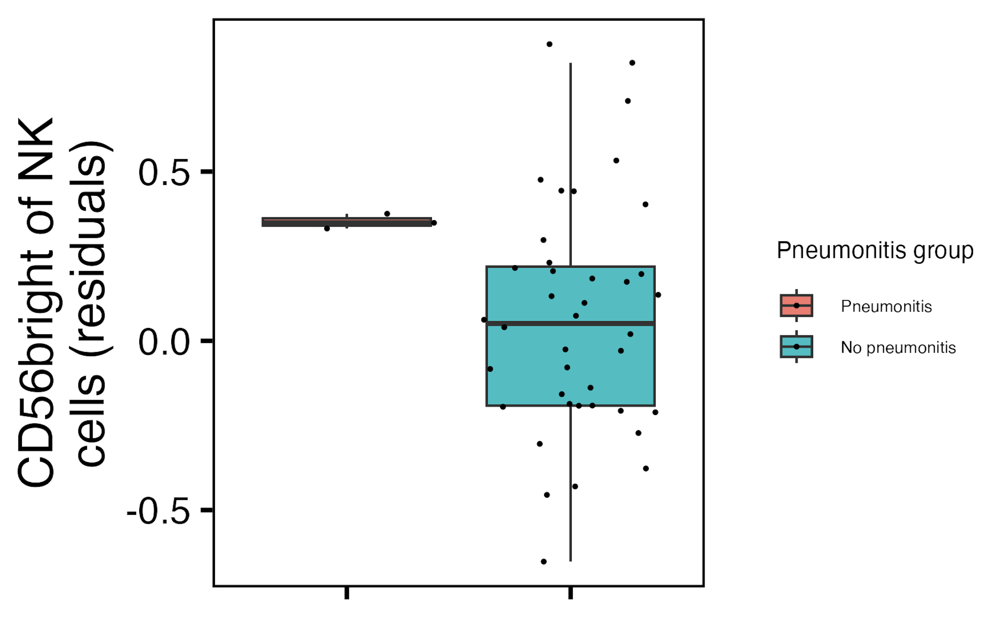
Baseline CD56^{bright} of NK cells frequency higher in those developing pneumonitis
padj = 3.4*10⁻⁴
Notes:
~similar if including pleural effusion (pval drops to 2.7 from 3.4)

Slide 6
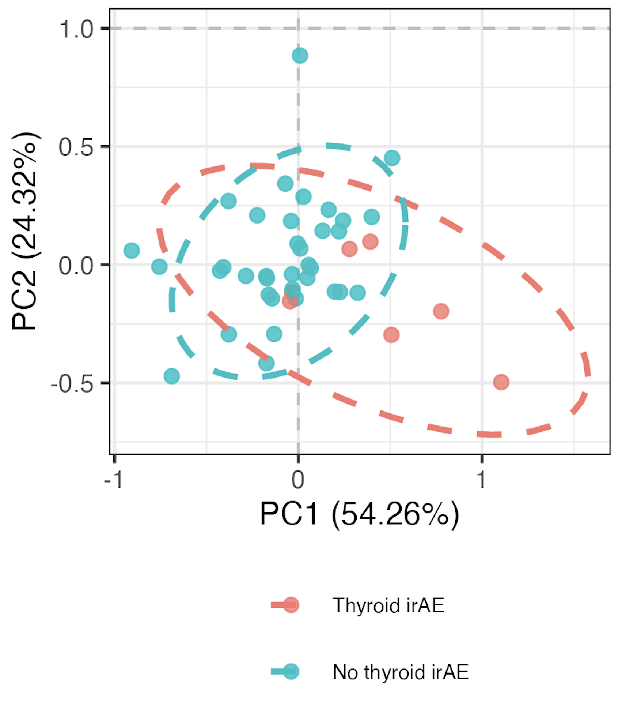
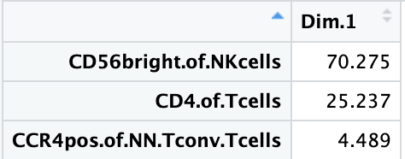
Using module of 3 baseline feature frequencies, can differentiate between those who develop thyroid irAEs
PC1 contributions
PC1 pval: 0.017
Notes:
~similar if including OOR in sense that module needed, contributing features are mostly different (CD4 of T cells present both ways)

Slide 7
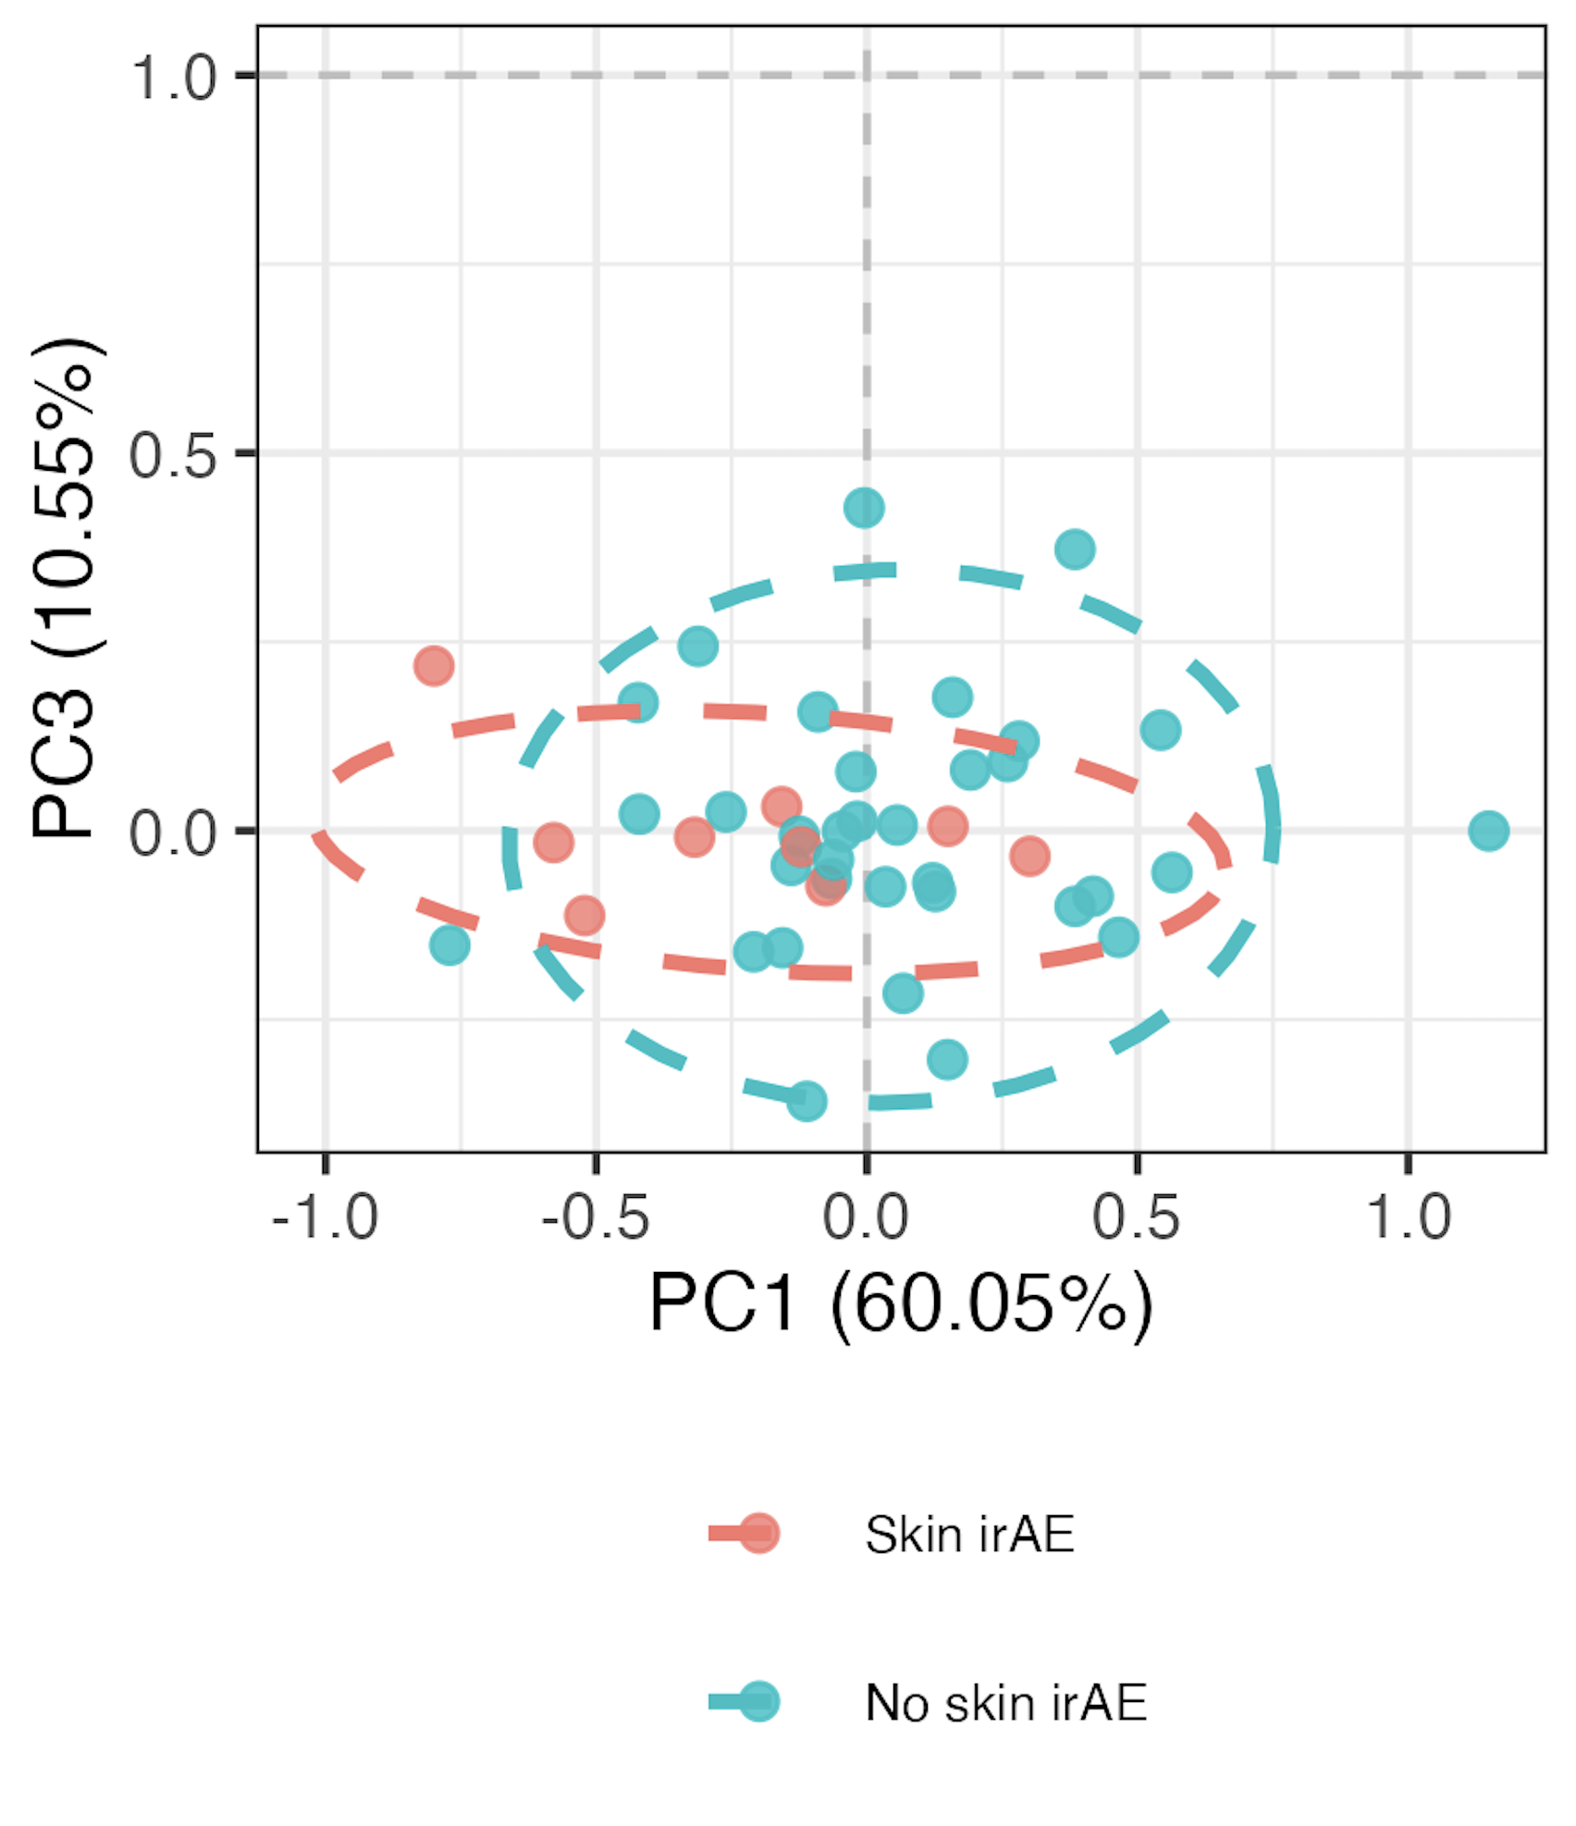
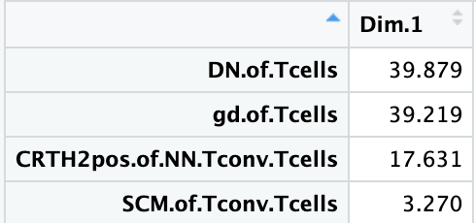
Using module of 4 baseline feature frequencies, can differentiate between those who develop skin irAEs
PC1 contributions
PC1 pval: 0.043

Slide 8
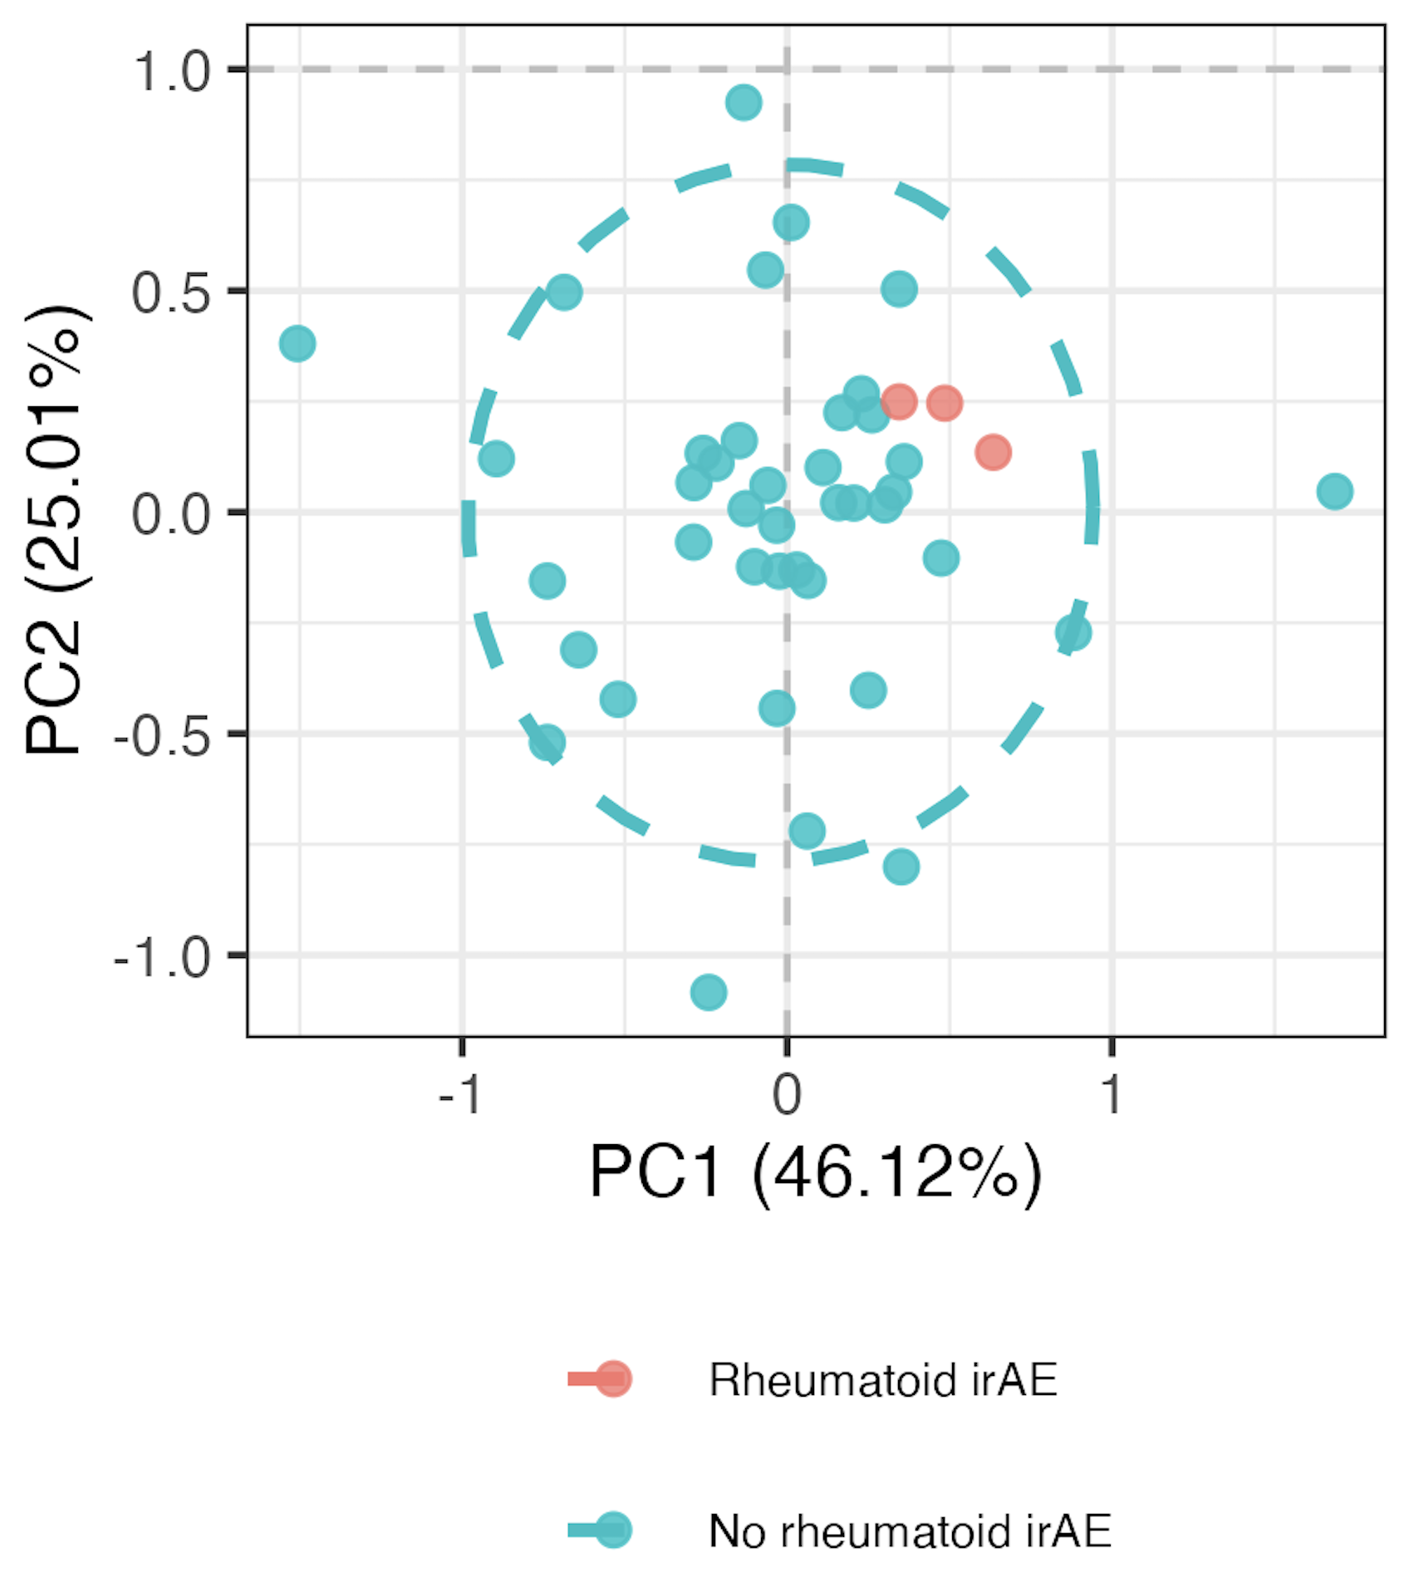
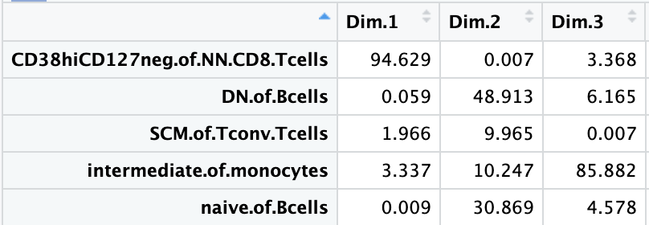
Using module of 5 baseline feature frequencies, can differentiate between those who develop “rheumatoid” irAEs
PC1 pval: 0.003
PC2 pval: 0.005
PC3 pval: 0.027

Slide 9
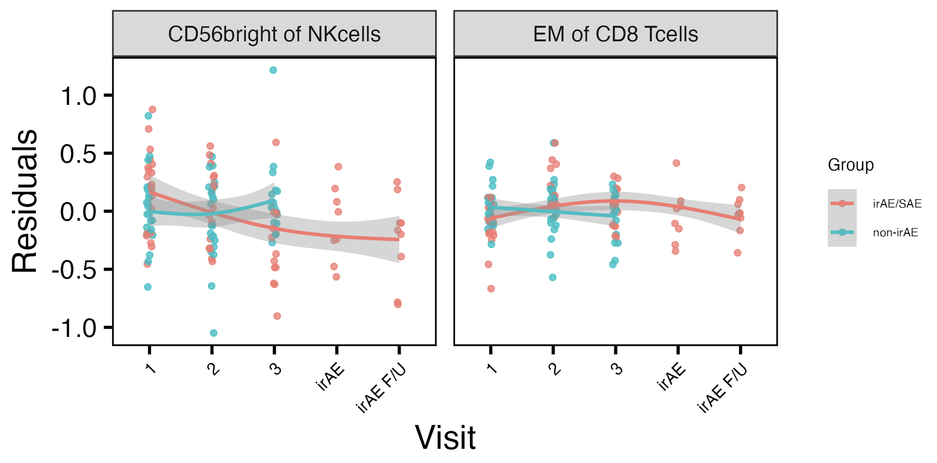
Longitudinal analyses: several features’ frequencies change in irAE group-specific manner over ICI
*
*
Used mixed effect non-linear model w/ interaction b/w irAE group & visit, random effect for donor
*: padj < 0.05
Notes:
GAM modeling
padj < 0.05
# CD56: visit3-group interaction (also see this for skin irAE instesd of combined)
# EM of CD8s: 2-group interaction

Slide 10
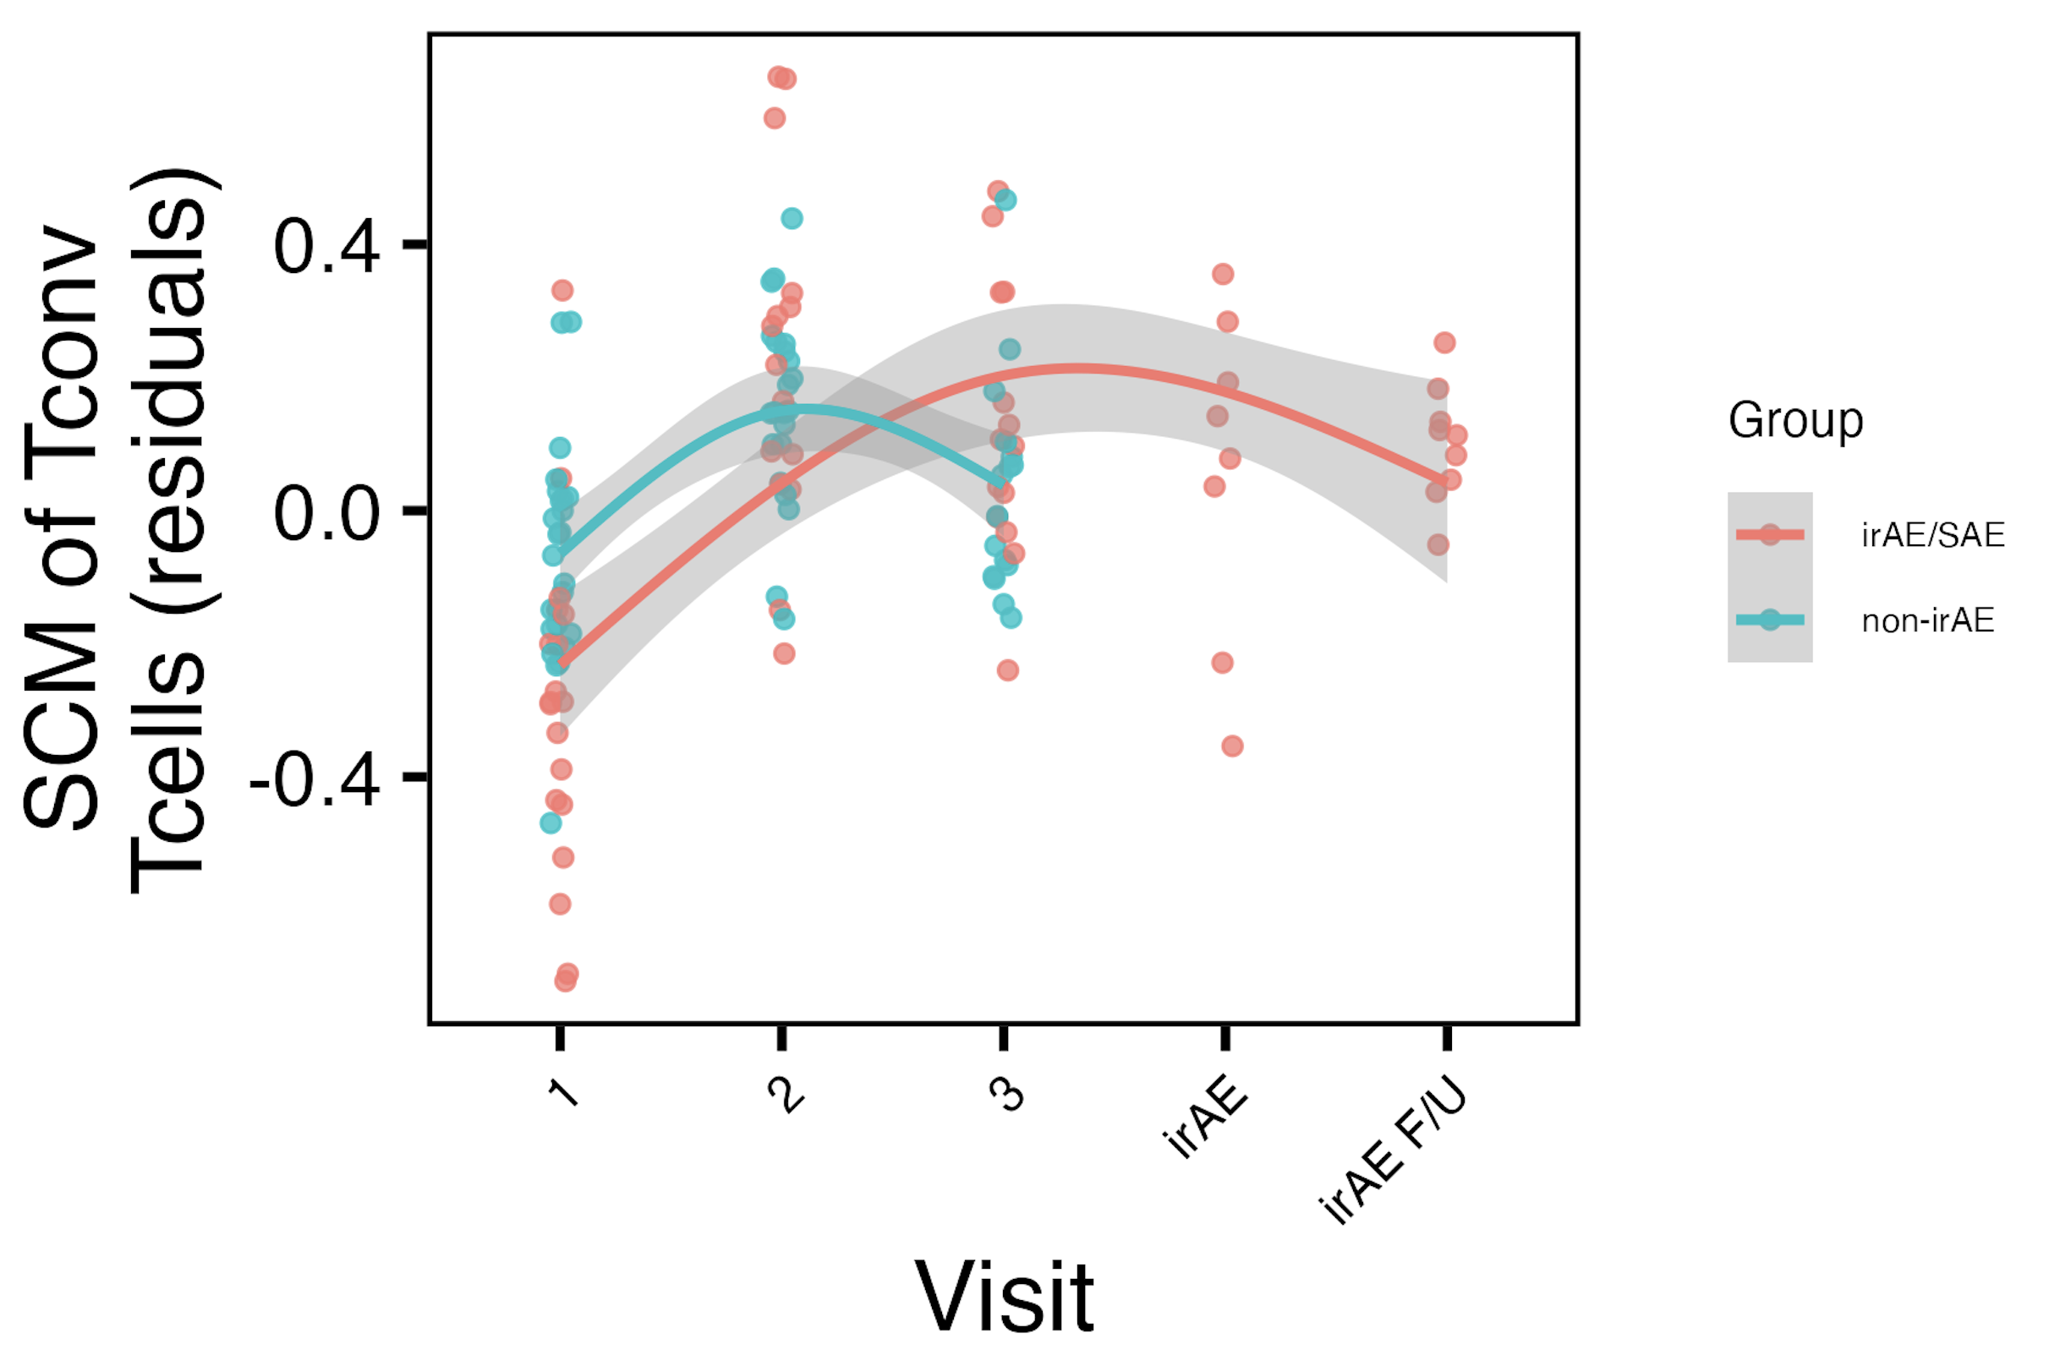
Frequency of SCM of T_{conv} T_{cells} is slightly elevated in non-irAE group at baseline, changes over visits in group-specific manner
*
*
*: padj < 0.05
Notes:
padj = 0.065 for baseline group comparison
# SCM of Tconv: group, visit2, visits2/3+group interaction results padj < 0.05

Slide 11
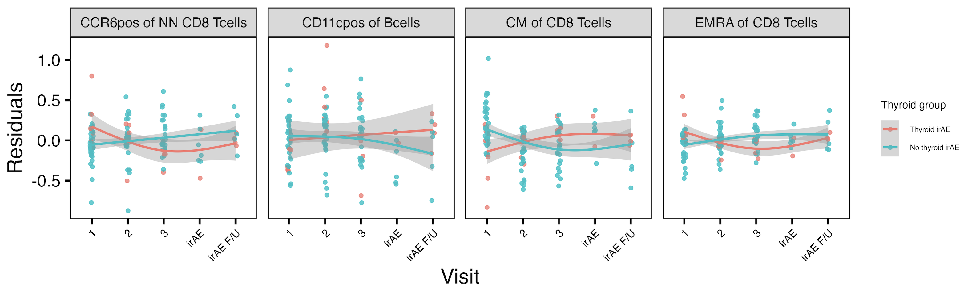
Longitudinal analyses: several features’ frequencies change in thyroid irAE group-specific manner over ICI
*
*
*
*
*: padj < 0.05

Slide 12
Conclusions
Baseline analyses
can use module of features to identify immunotypes of combined irAE, thyroid irAEs, skin, “rheumatoid” irAEs at baseline
baseline CD56^{bright} of NK cells frequency higher in those developing pneumonitis
Longitudinal analyses: some feature frequencies change with ICI in irAE group-specific manner
combined irAEs: CD56^{bright} of NK cells, EM of CD8s
thyroid irAEs: CCR6⁺ of NN CD8s, CD11c⁺ of Bcells, CM of CD8s, EMRA of CD8s
Notes:
CD56bright of Nkcells start high in irAE (baseline) and then decrease w/ ICI, opposite for non-irAE
EM of CD8s start high in non-irAE and decrease w/ ICI, opposite for irAE
SCM of Tconv Tcells: ICI increases baseline freq, non-irAE freq returns to baseline sooner
CCR6pos of NN CD8s: start high in thyroid irAE and decrease with ICI, opposite for non-thyroid irAE, same for EMRA of CD8s
CD11cpos of Bcells increases with ICI in thyroid irAE, decreases with ICI in no thyroid irAE
CM of CD8s starts high in no thyroid irAE decreases with ICI, opposite for thyroid irAE

Slide 13
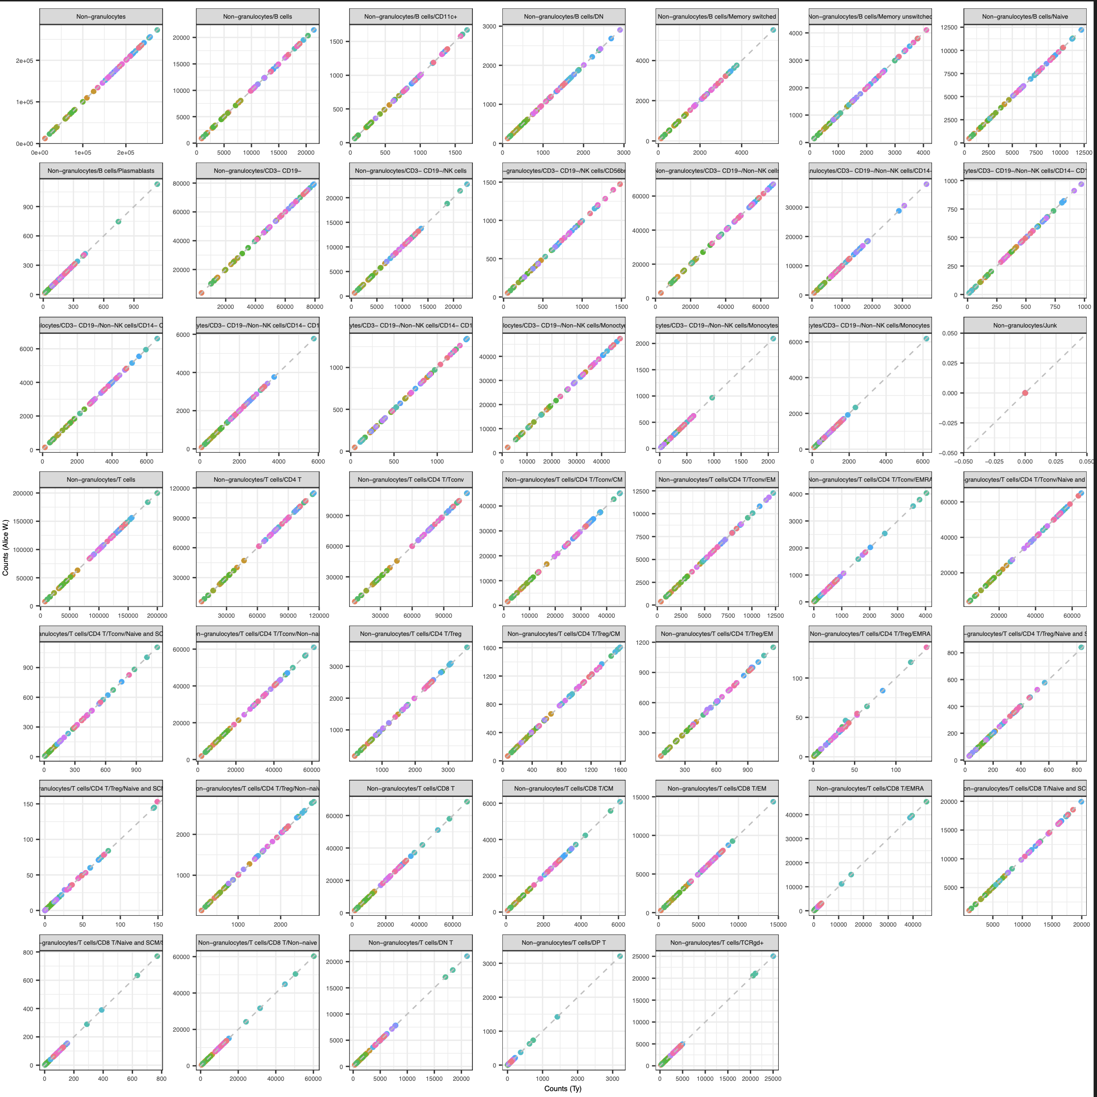
Next steps
IMPACD
created gating set in R, counts are ~expected values
will next look at gating at multiple, hierarchical levels
Test baseline irAE modules in public datasets

Slide 14

Acknowledgements
Holly Akilesh
Long lab/HIPcore
Alice Long, Alice Wiedeman
Buckner lab
Jane Buckner, Sylvia Posso
Peter Linsley
Clinical team

Slide 15
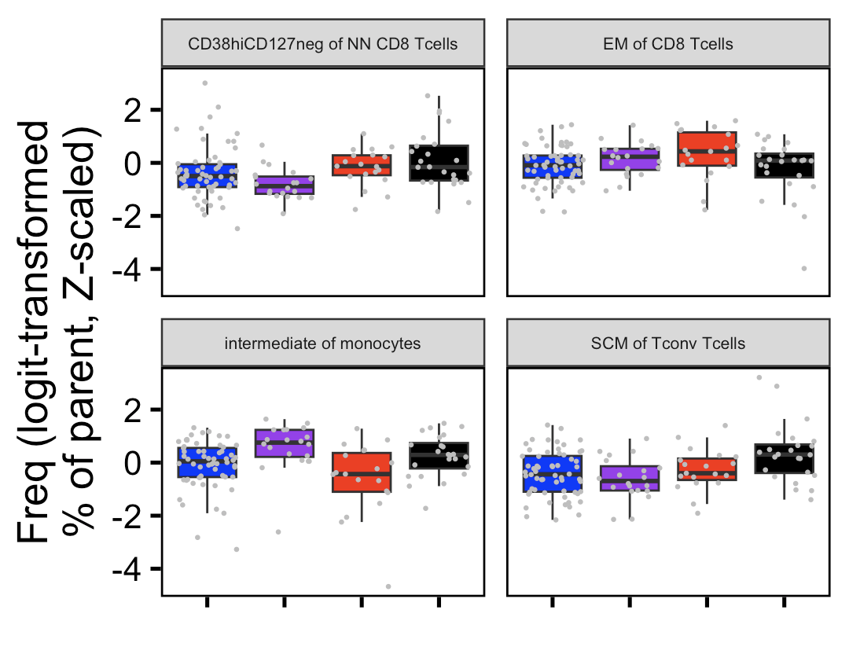
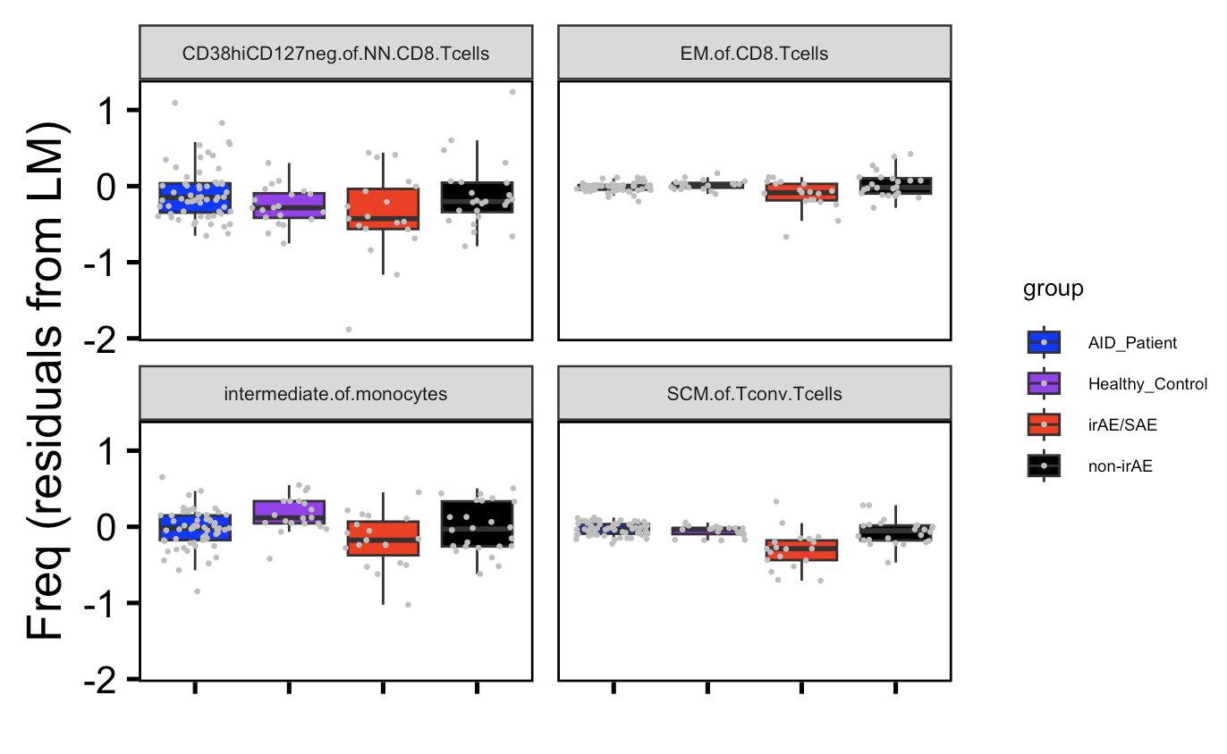
Visualizing a few features pre/post batch correction (baseline data)
Pre-batch correction
Post-batch correction

Slide 16
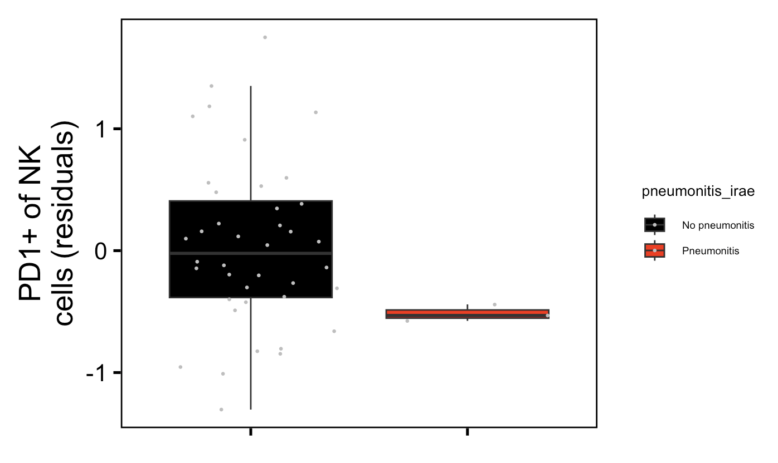
PD1⁺ of NK frequencies may be lower in baseline samples of those developing pneumonitis
Pneumonitis (n = 3): padj = 0.001
Notes:
Feature lost when using all data to regress out effect of batch, so here not using all data to regress batch out (only baseline cancer data)

Slide 17
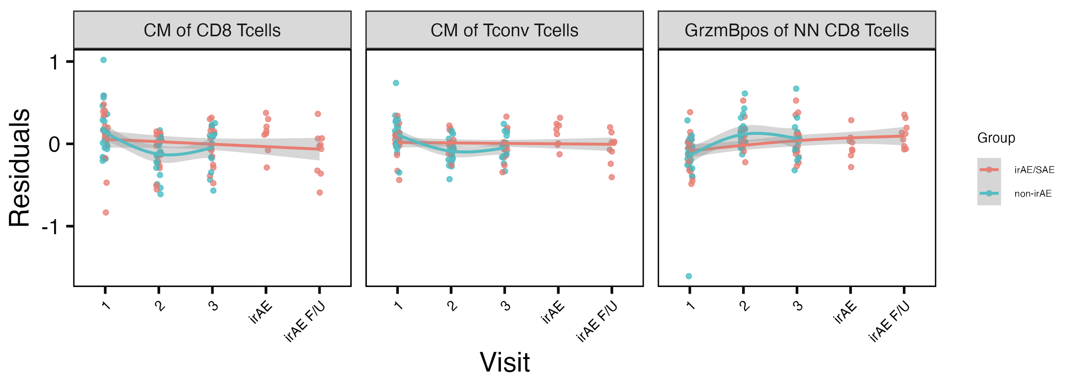
Longitudinal analyses: ICI effects across combined irAE groups
*
**
*
Notes:
padj < 0.05
# CM of CD8s: visit2
# CM of Tconv: visit 2, ** (padj < 0.01)
# GzmB: visit2

